Slide 1
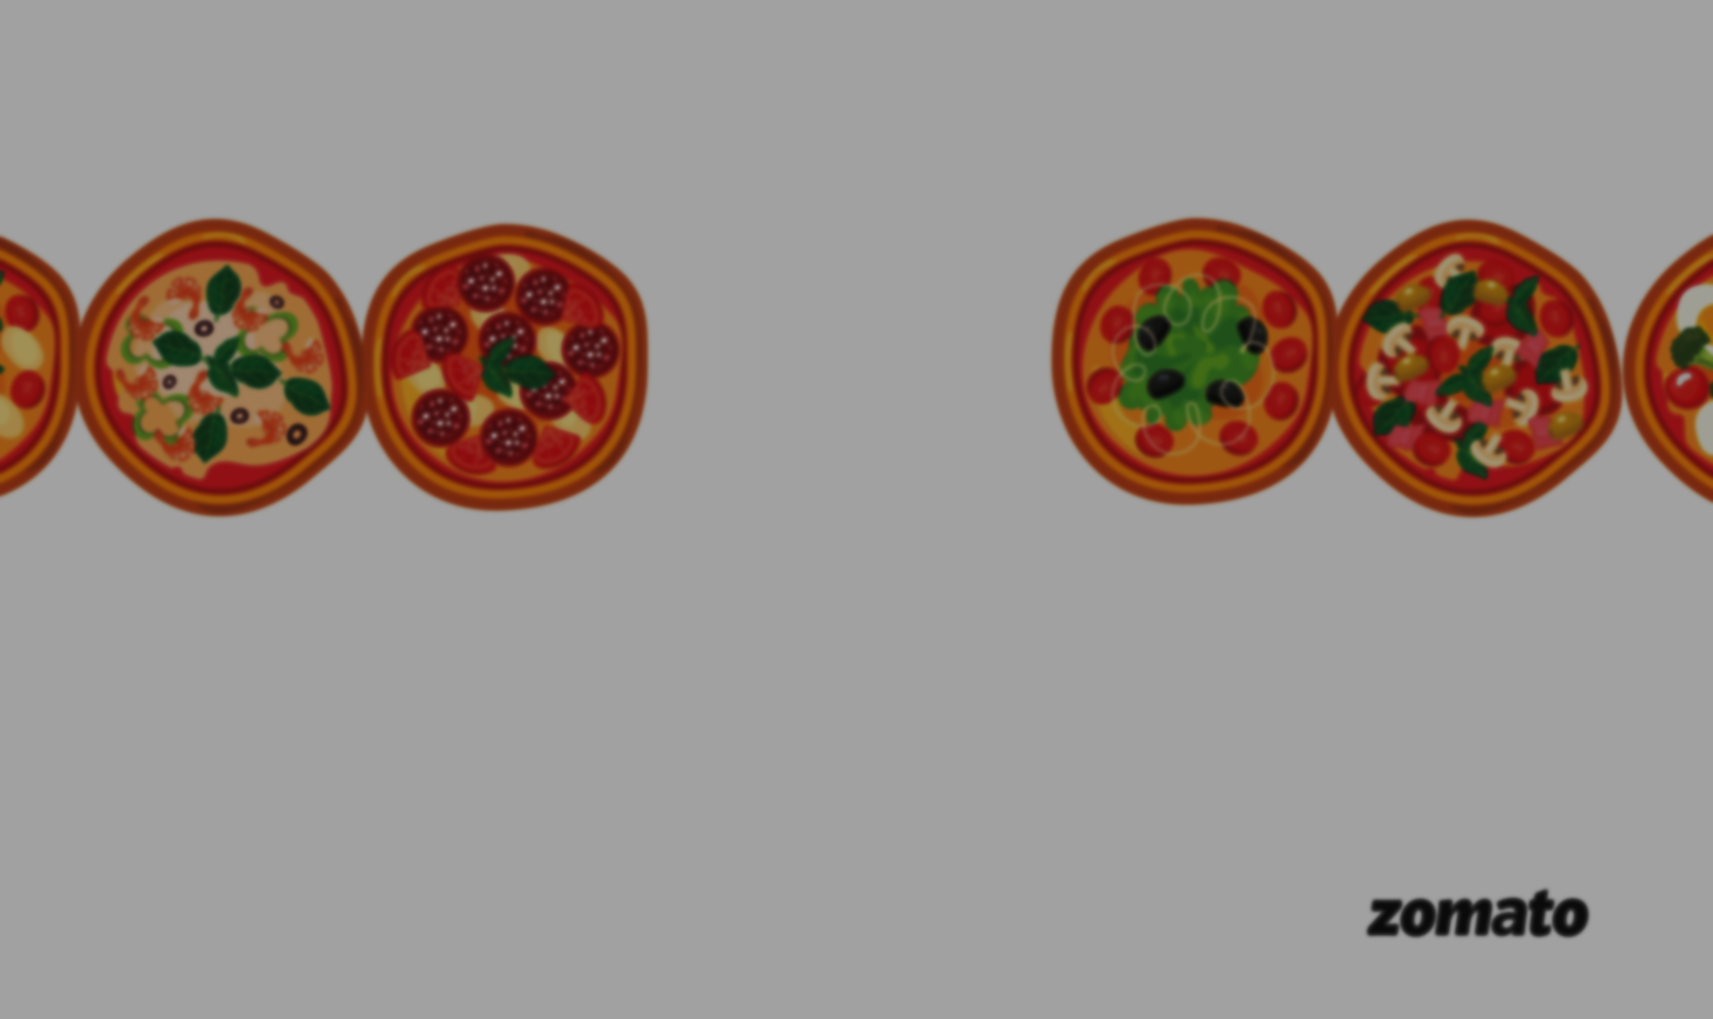
Zomato Data Analysis
Insights for Smarter Restaurant Investments

Slide 2
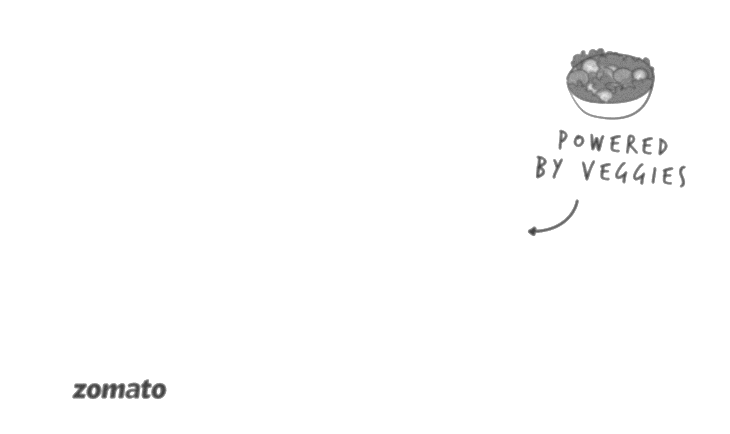

INDEX
1. Introduction
2. Objective
3. Dashboard
4. Insights
4.1 Safest Cities to Invest In
4.2 Top Fast Food Joints to Invest In
4.3 Top Restaurants to Invest In
4.4 Average Votes and Photos by Rating
4.5 Average Rating by Cost
4.6 Popular Cuisines to Invest In for Each City
4.7 Cities with High Delivery Counts
4.8 Opportunity to Open Multiple Famous Fast Food Joints
5. Conclusion

Slide 3
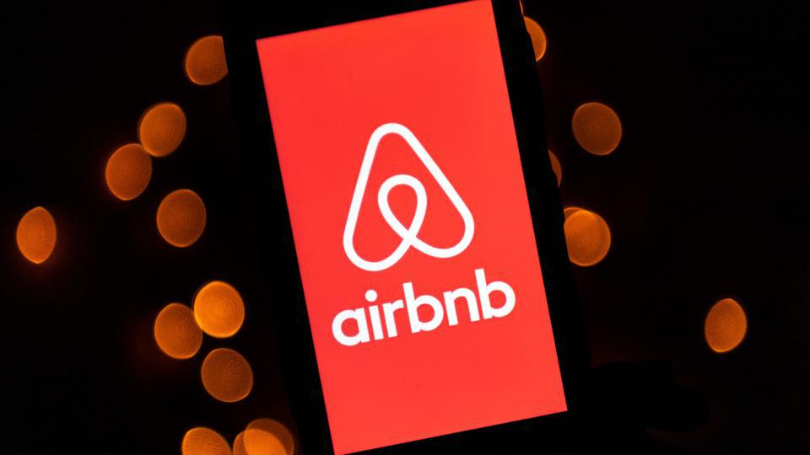
1. Introduction
This presentation focuses on analyzing restaurant data to identify key investment opportunities and to improve sales efficiency. By examining various metrics such as ratings, cost, and the number of outlets, we aim to uncover insights that can guide strategic decisions.
The dataset consists of information on various restaurants, including their names, establishment types, cities, localities, cuisine types, timings, average cost for two people, price ranges, highlights, and ratings

Slide 4
2. Objective
Our analysis covers several aspects, including:
Top-Rated Restaurants for Investment: We highlight restaurants with high ratings that are not part of large chains, providing potential investment opportunities in unique establishments.
Average Ratings by City: This section identifies cities where restaurants have the highest average ratings, helping investors target the safest cities for investment.
Top Fast Food Joints: We explore fast food chains that strike a balance between high ratings and a substantial number of outlets, offering insights into popular and successful brands.
Cost vs. Rating Analysis: This analysis determines the best cost for two people that balances restaurant count and average rating, guiding pricing strategies.
Opportunity for Improvement: We identify restaurants with lower ratings, presenting opportunities for improvement and potential turnaround investments.
Popular Cuisines by City: Understanding the top-ranked cuisines in various cities helps in tailoring restaurant offerings to local preferences.

Slide 5
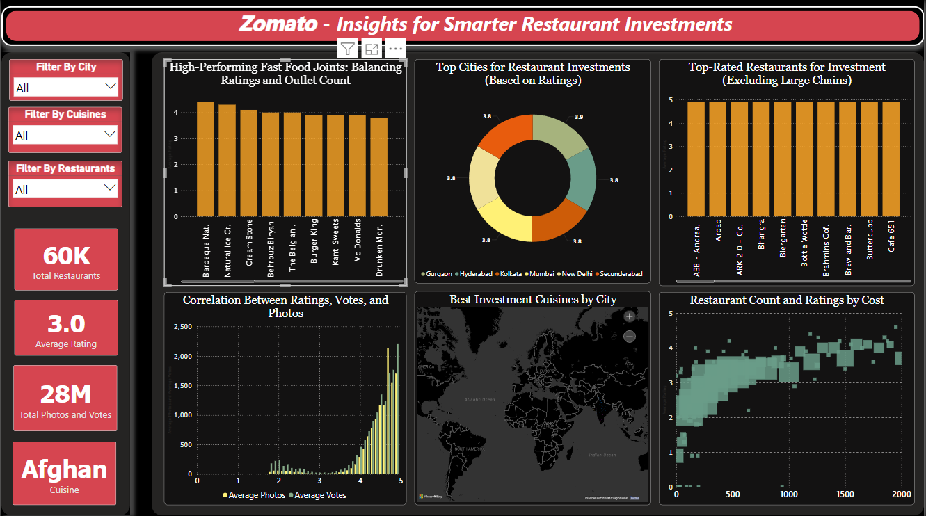
3. Dashboard

Slide 6
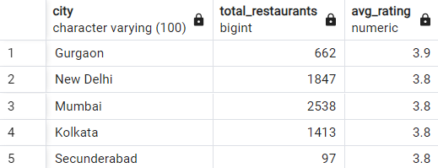
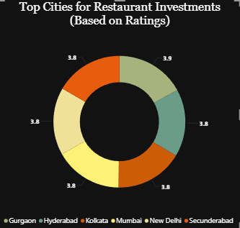
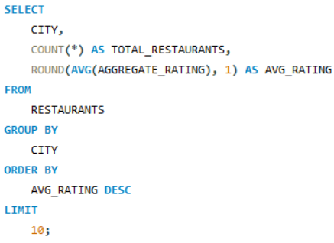
4. INSIGHTS
4.1 Safest Cities to Invest In
1. What are the safest cities to invest in based on restaurant ratings?
- Cities with higher average ratings, such as Gurgaon, are generally safer investments. For example, Gurgaon has an average rating of 3.9, suggesting a stable and profitable market for expansion.

Slide 7
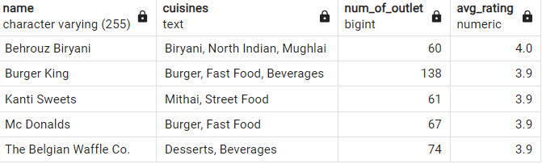
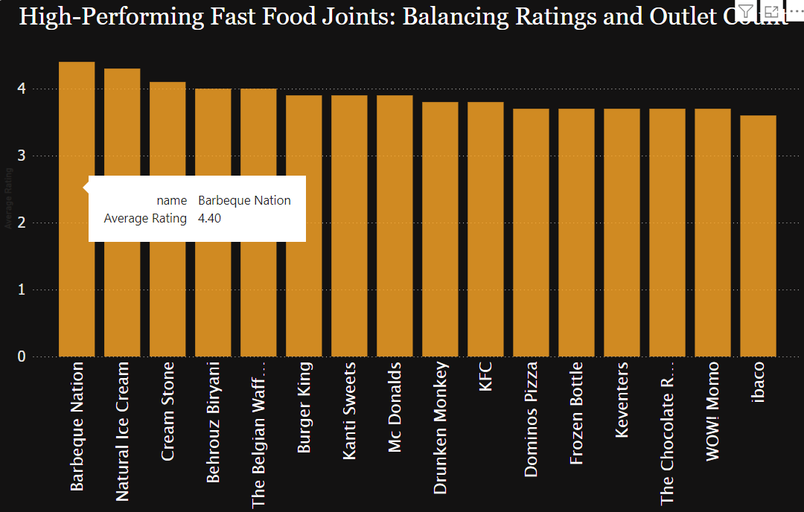
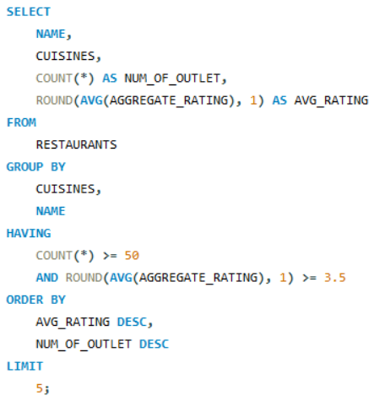
4.2 Top Fast Food Joints to Invest In
2. Which fast food joints offer the best balance between high ratings and the number of outlets?
- Fast food joints like Behrouz Biryani, Burger King which have a high average rating and a significant number of outlets, are promising investment opportunities. These businesses have demonstrated both popularity and customer satisfaction.

Slide 8
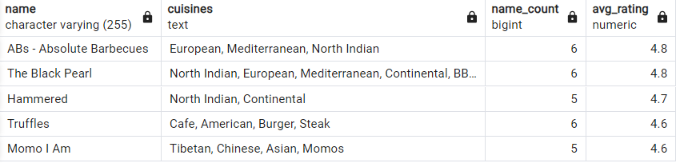
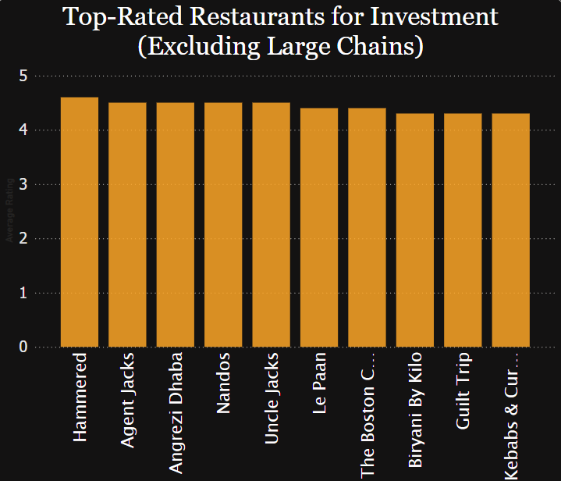
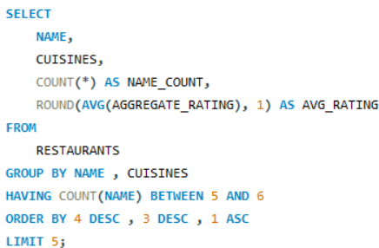
4.3 Top Restaurants to Invest In
3. What are the top restaurants to invest in that aren't part of large chains?
- Restaurants like Hammered, Agent Jacks have great ratings and a good number of locations, making them good investment choices. They get excellent customer feedback and aren't as common as big chains.

Slide 9
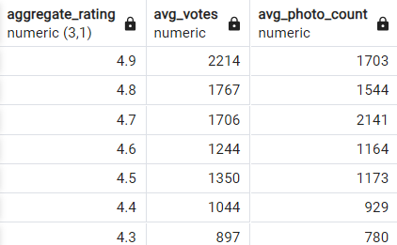
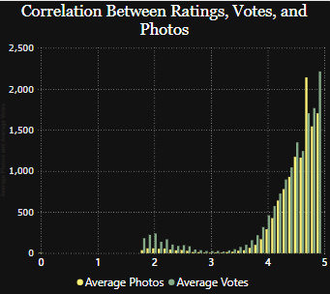
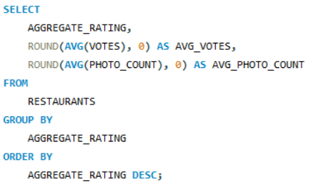
4.4 Average Votes and Photos by Rating
4. How do ratings relate to the number of votes and photos?
- Higher ratings usually mean more votes and photos. For example, restaurants with a rating between 4.5 to 5 often have about 1500-2000 votes and photos for each, showing they have more customer engagement.

Slide 10
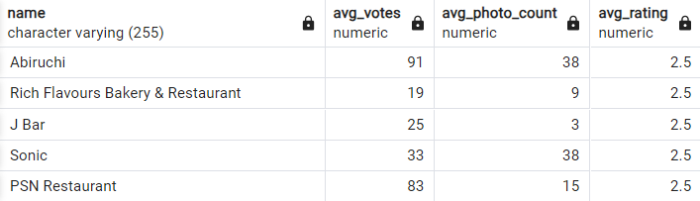
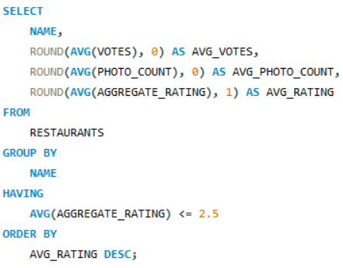
4.4 Average Votes and Photos by Rating
5. Which restaurants with low ratings might need improvements?
- Restaurants with ratings of 2.5 or less, like Abiruchi, J Bar could improve their quality and service. These places often have fewer votes and photos, suggesting they need better customer engagement.

Slide 11
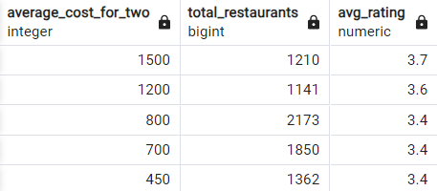
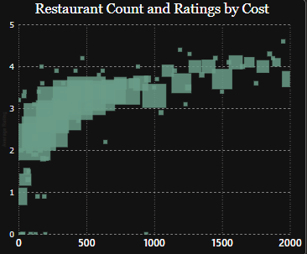
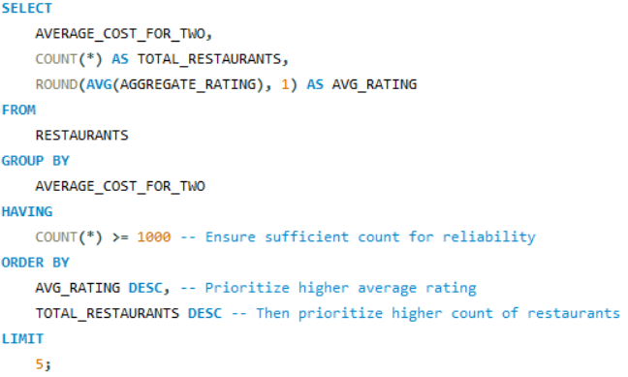
4.5 Average Rating by Cost
6. What is the best cost for two people to get high ratings and a lot of restaurant options?
- Cost of about 800 for two people often leads to high ratings and many restaurant choices. This price is good for balancing cost and quality.

Slide 12
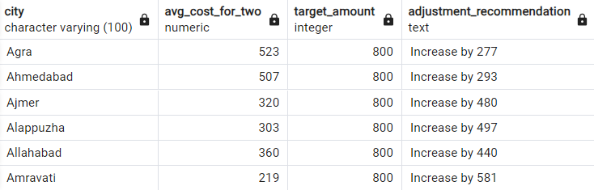
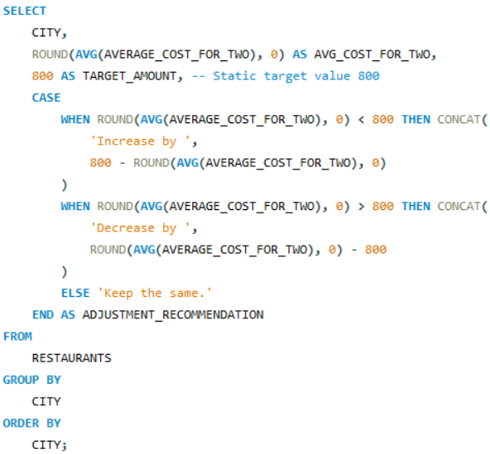
4.5 Average Rating by Cost
7. How should pricing be adjusted in different cities to match the 800 standard for two people?
- In cities like Ajmer, where the average cost for two people is 320, pricing might need to be adjusted. If the cost is higher than 800, consider lowering it to stay competitive, and vice versa.

Slide 13
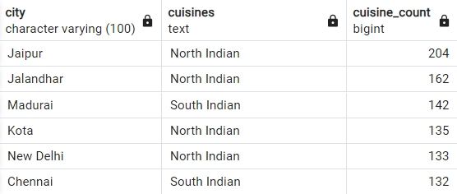
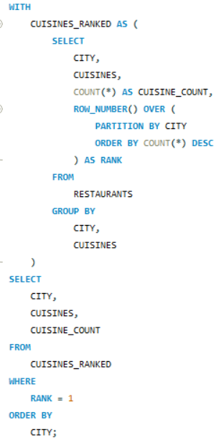
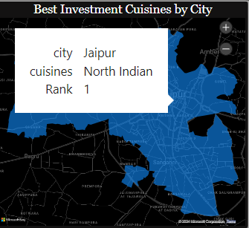
4.6 Popular Cuisines to Invest In for Each City
8. What are the best cuisines to invest in for different cities?
- The most popular cuisines vary by city. For instance, focusing on top-ranked cuisines like North Indian in Jaipur, Jalandhar etc. can help match investment strategies with local tastes.

Slide 14
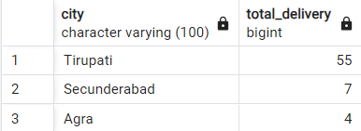
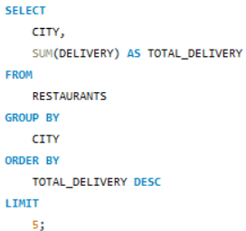
4.7 Cities with High Delivery Counts
9. Which cities should restaurants focus on improving their delivery times?
- Cities like Tirupati with many delivery options offer a great chance for restaurants to improve their service, especially by speeding up delivery times. Enhancing delivery efficiency in these areas could lead to better customer satisfaction and increased orders.

Slide 15
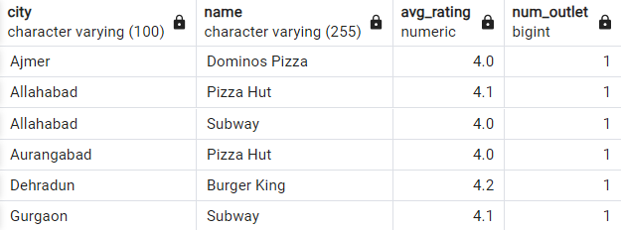
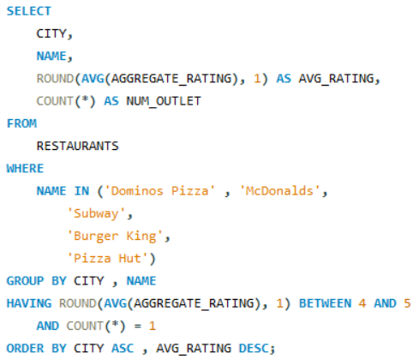
4.8 Opportunity to Open Multiple Famous Fast Food Joints
10. Where should we think about expanding successful fast food joints that have few outlets?
- Expanding popular fast food joints like Dominos Pizza, Burger King in cities like Ajmer, Dehradun, where they have high ratings but few outlets, could be a smart move.

Slide 16
5. Conclusion
Ways to Improve Sales and Operations.
Promotions: Launch targeted promotions in high-rating cities to attract more customers.
Quality Maintenance: Ensure consistent quality to sustain high ratings and customer satisfaction.
Franchise Expansion: Consider franchising successful high-rated fast food joints.
Operational Efficiency: Streamline processes to maintain high ratings across all outlets.
Market Expansion: Explore opportunities for expanding high-rated restaurants.
Personalized Services: Enhance customer experiences to leverage high ratings.
Encourage Reviews: Motivate customers to leave reviews and upload photos for better visibility.
Marketing: Highlight high-rated restaurants in marketing campaigns.
Quality Improvements: Invest in food quality and service enhancements to boost ratings.
Customer Feedback: Use feedback to identify and address improvement areas.
Pricing Strategy: Adjust pricing to align with the optimal cost range and market trends.
Value Proposition: Ensure the dining experience justifies the cost to attract more customers.
Targeted Expansion: Focus on popular cuisines in high-ranking cities to maximize potential.
Local Partnerships: Collaborate with local suppliers and chefs to enhance authenticity.
Delivery Optimization: Improve delivery services in top cities to increase customer satisfaction.
Partnerships: Partner with local delivery services to expand reach.
Expansion Planning: Develop expansion plans based on thorough market analysis.

